Slide 1
Exit Strategies
Dr. Narayanan Jayaraman
Georgia Institute of Technology

Slide 2
Objectives
In this session we want you to……
Exit strategies of the investors, including going public

Slide 3
Issues in IPOs
IPO Timing
IPO Process
Marketing the Offering
Time and Responsibility Issues
Current Public Offering Environment

Slide 4
IPO Timing and Conditions
Stages of Corporate Financings
Venture
Public Debt
& Equity
PROFIT
IPO
Seed
TIME

Slide 5
IPO Timings and Conditions
Pros of Going Public
  Liquidity
  Capital for acquisitions & growth
  Enhanced ability to raise additional capital
  Higher valuation
  Higher profile

Slide 6
IPO Timings and Conditions
Cons of going public
  Offering costs: time and money
  On-going time requirements of management
  Cost of investor relations (i.e.., annual and quarterly reports)
  Quarterly scrutiny of financial results
  Net worth of principals becomes public

Slide 7
IPO Timings and Conditions
When should you go public?
  Conditions necessary to complete an IPO
  The objectives:
    Achieve the highest market valuation
    Position the stock to go up
  Valuation Methodologies

Slide 8
IPO Timings and Conditions
Conditions Necessary to Complete IPO
  Management team in place
  Strong Financial controls
  Sufficient offering size
  Solid operating history; bright prospects
  Good industry and market conditions
  Valid use of proceeds

Slide 9
IPO Timings and Conditions
Objective - Highest Market Valuation
  Minimize the cost of equity capital
  Minimize dilution to existing owners

Slide 10
IPO Timings and Conditions
Ownership Dilution Example - Company Size
Net Income $2,000 $3,000 $4,000
P/E Multiple 10x 10x 10x
Pre-Deal Valuation $20,000 $30,000 $40,000
IPO Proceeds $20,000 $20,000 $20,000
Post-deal Valuation $40,000 $50,000 $60,000
Ownership Given Up 50% 40% 33%

Slide 11
IPO Timings and Conditions
Valuation Methodologies
  Comparable company analysis
  Multiple of price to:
    projected earnings
    trailing earnings
    cash flow
    book value
  Discount to comparable
  company multiples

Slide 12
IPO Process
Components of an IPO
IPO Offering
Aftermarket Support
Cost of Equity Capital

Slide 13
IPO Process
Who are the Key Players?
  Investment Banker
  Company counsel
  Underwriters’ counsel
  Accounting firm
  Financial printer
  Financial public relations firm

Slide 14
IPO Process
Investment Banker / Managing Underwriter Role:
  Quarterbacking the offering
  Understand incentives
  Decide sole vs. co-managed offering
  Consider qualifications
  Avoid “highball” valuation
  Evaluate personal chemistry
  Determine commitment
  Evaluate merits of regional vs. Wall Street underwriter

Slide 15
IPO Process
Investment Banking Qualifications
  Corporate finance
  Research
  Syndicate
  Sales Force
  Market making

Slide 16
IPO Process
Company Counsel
  Role: Draft the document
    Ensures accurate information
  Use of special counsel
  Importance of extensive recent SEC experience
  Focus on corporate house cleaning

Slide 17
IPO Process
Underwriter’s Counsel
  Role: Assist underwriters in due diligence
    Assists in drafting
  Importance of broad SEC experience
  Ability to handle Blue Sky clearances
  Importance of good relationship with company / special counsel

Slide 18
IPO Process
Accounting Firm
  Role: Provides audited financial information
    Verifies key numbers in prospectus
  Merits of national firm
  Experience with SEC requirements
  Importance of relationship with SEC
  Ability to provide comfort letter

Slide 19
IPO Process
Financial Printer
  Role: Accurately prints the document
  Experience in SEC filings
  Ability to print color or other special formats on-site
  Costs competitiveness

Slide 20
IPO Process
Financial Public Relations Firm
  Preparation of roadshow presentation
  Merits of regional vs. New York firm
  Importance of experience with IPOs
  Assistance with press & earnings releases and
  quarterly annual reports
  Ability to work well with management
  Cost competitiveness

Slide 21
IPO Process
Where the Investors Are
2,200 at 300 firms
Sell-Side
Analysts
Buy-Side
Analysts
Institutional Investors
Brokers
Individual Investors - 45 million in U.S.

Slide 22
IPO Process
What does an IPO Cost?
  Financial Costs
    Expenses paid by the company
    Underwriting discount
  Indirect costs

Slide 23
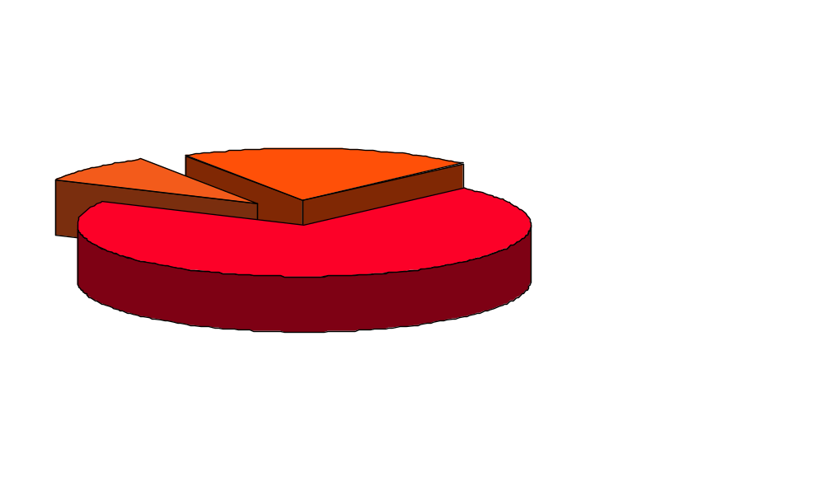
IPO Process
Underwriting Discounts
IPOs with Spreads < 7%
IPOs with
Spreads >7%
IPOs with Spreads = 7%

Slide 24
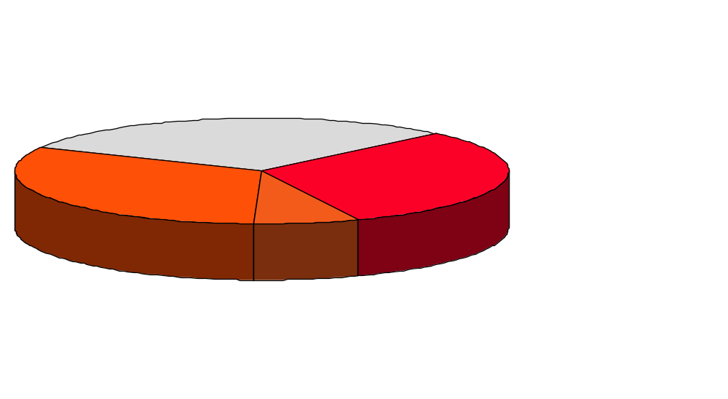
IPO Process
IPOs
Estimated Expenses
$750,000 to
$1,000,000
30%
32%
$500,000 to
$750,000
31%
7%
Over $1 MM
Under $500,000

Slide 25
IPO Process
Indirect Costs
  Senior management’s time:
    Picking the players
    Due diligence and management interviews
    Drafting
    Marketing
  Post-deal reporting requirements and investor relations:
    News releases
    Quarterly / annual reports
    SEC filings / public announcements
    Board
    Stockholders’ meeting

Slide 26
Marketing the Offering
What is required
  Marketing Strategy
  Syndicated Formation
  Roadshow Presentation
  Pricing

Slide 27
Marketing the Offering
Select logical buyers
Determine retail vs. institutional focus
Consider foreign investors
Create scarcity value

Slide 28
Marketing the Offering
Roadshow Presentation
  Focus on management team
  Length (20-25 minutes)
  Key Topics
    Comparable strengths, market niche, future prospects
  Typical audience
    Brokers, analysts, institutions
  Building momentum and scarcity value

Slide 29
Marketing the Offering
Pricing
  Complete SEC review
  Analyze market conditions
  Evaluate feedback and build block book
  Leave something on the table
  Sign underwriting agreement

Slide 30
Time & Responsibility Schedule For IPO
Week 1 Time Schedule set for Planning Purposes
Organizational Meeting
Due Diligence Commences
Week 2 - 7 Due Diligence Meetings
Drafting Sessions
Week 7 Registration Statement Filed with SEC
Week 11 - 13 Comments Received from the SEC
Road Shows - Retail & Institutional
Week 14 Pricing
Registration Statement Becomes Effective
Public Offering Commences
Week 15 Closing

Slide 31
Public Offering Environment
Year S&P 500 Return
___________________________________________
2016 12%
2015 1%
2014 13%
2013 30%
2012 13%
2011 0%
2010 15%
2009 26%
2008 -37%
2007 4%
2006 13%
2005 5%
2004 11%
2003 29%
2002 -22%
2001 -12%
2000 -10%

Slide 32
Mean First-day Returns and Money Left on the Table, 1980-2016
# Equal Value Money Left Aggreg. Proceeds
1980 | 71 | 14.3% | 20.0% | $0.18 billion | $0.91 billion
1981 | 192 | 5.9% | 5.7% | $0.13 billion | $2.31 billion
1982 | 77 | 11.0% | 13.3% | $0.13 billion | $1.00 billion
1983 | 451 | 9.9% | 9.4% | $0.84 billion | $8.89 billion
1984 | 172 | 3.6% | 2.5% | $0.05 billion | $2.06 billion
1985 | 187 | 6.4% | 5.3% | $0.23 billion | $4.31 billion
1986 | 393 | 6.1% | 5.1% | $0.68 billion | $13.40 billion
1987 | 285 | 5.6% | 5.7% | $0.66 billion | $11.68 billion
1988 | 102 | 5.7% | 3.5% | $0.13 billion | $3.72 billion
1989 | 113 | 8.2% | 4.7% | $0.24 billion | $5.20 billion
1990 | 110 | 10.8% | 8.1% | $0.34 billion | $4.27 billion
1991 | 286 | 11.9% | 9.7% | $1.50 billion | $15.35 billion
1992 | 412 | 10.3% | 8.0% | $1.82 billion | $22.69 billion
1993 | 509 | 12.7% | 11.2% | $3.50 billion | $31.35 billion
1994 | 403 | 9.8% | 8.5% | $1.46 billion | $17.25 billion
1995 | 461 | 21.2% | 17.5% | $4.90 billion | $27.95 billion
1996 | 677 | 17.2% | 16.1% | $6.76 billion | $42.05 billion
1997 | 474 | 14.0% | 14.4% | $4.56 billion | $31.76 billion
1998 | 281 | 21.9% | 15.6% | $5.25 billion | $33.65 billion
1999 | 477 | 71.1% | 57.1% | $37.11 billion | $64.95 billion
2000 | 381 | 56.3% | 46.0% | $29.83 billion | $64.86 billion
2001 | 79 | 14.2% | 8.7% | $2.97 billion | $34.24 billion
2002 | 66 | 9.1% | 5.1% | $1.13 billion | $22.03 billion
2003 | 63 | 11.7% | 10.4% | $9.96 billion | $9.54 billion
2004 | 173 | 12.3% | 12.4% | $3.86 billion | $31.19 billion
Jay Ritter’s
IPO database

Slide 33
Mean First-day Returns and Money Left on the Table, 1980-2016
2005 | 159 | 10.3% | 9.3% | $2.64 billion | $28.23 billion
2006 | 157 | 12.1% | 13.0% | $3.95 billion | $30.48 billion
2007 | 159 | 14.0% | 13.9% | $4.95 billion | $35.66 billion
2008 | 21 | 5.7% | 24.8% | $5.63 billion | $22.76 billion
2009 | 41 | 9.8% | 11.1% | $1.46 billion | $13.17 billion
2010 | 91 | 9.4% | 6.2% | $1.84 billion | $29.82 billion
2011 | 81 | 13.9% | 13.0% | $3.51 billion | $26.97 billion
2012 | 93 | 17.8% | 8.9% | $2.77 billion | $31.11 billion
2013 | 157 | 21.1% | 20.5% | $7.94 billion | $38.75 billion
2014 | 206 | 15.5% | 12.8% | $5.40 billion | $42.20 billion
2015 | 115 | 18.7% | 18.7% | $4.06 billion | $21.72 billion
2016 | 74 | 14.6% | 14.4% | $1.75 billion | $12.12 billion
1980-1989 | 2,043 | 7.3% | 6.1% | $3.27 billion | $53.47 billion
1990-1998 | 3,613 | 14.8% | 13.3% | $30.09 billion | $226.36 billion
1999-2000 | 858 | 64.5% | 51.6% | $66.94 billion | $129.81 billion
2001-2016 | 1,735 | 14.0% | 12.8% | $54.84 billion | $430.00 billion
1980-2016 | 8,249 | 17.9% | 18.5% | $155.14 billion | $839.65 billion

Slide 34
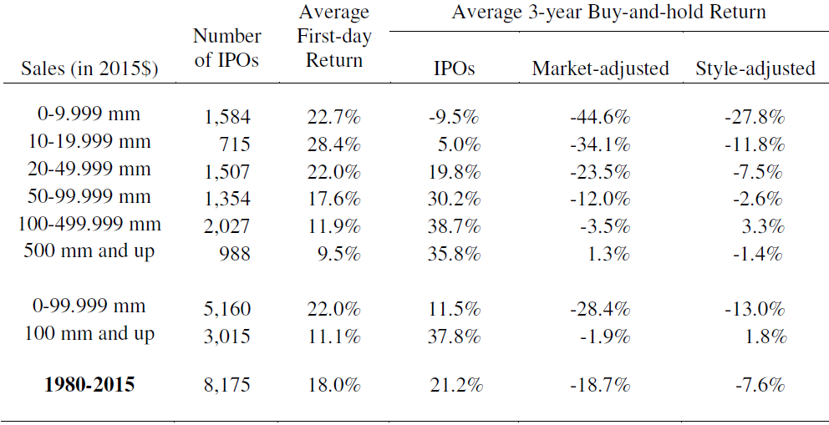
Long-run Returns on IPOs Categorized by the Pre-issue Sales of the Firm, 1980-2015

Slide 35
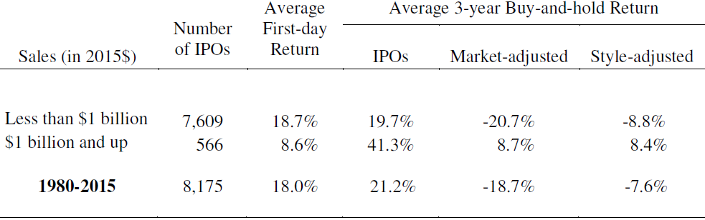
Long-run Returns on IPOs Categorized by the Pre-issue Sales of the Firm, 1980-2015

Slide 36
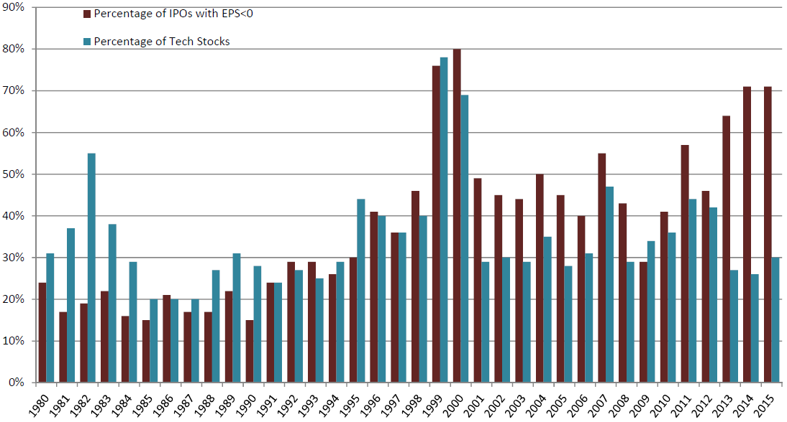
Percentage of IPOs with Negative EPS and Percentage of Tech Stocks, 1980-2015

Slide 37
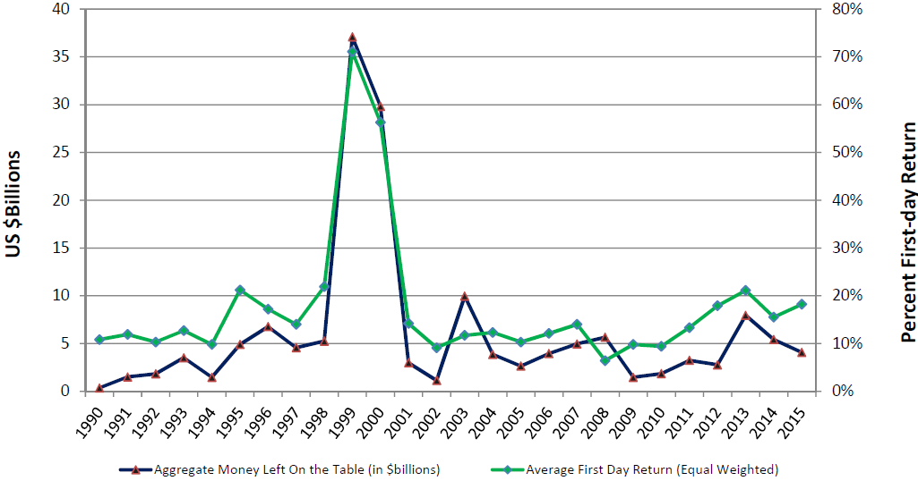
Average First Day Return and Aggregate Money Left On the Table, 1990-2015

Slide 38
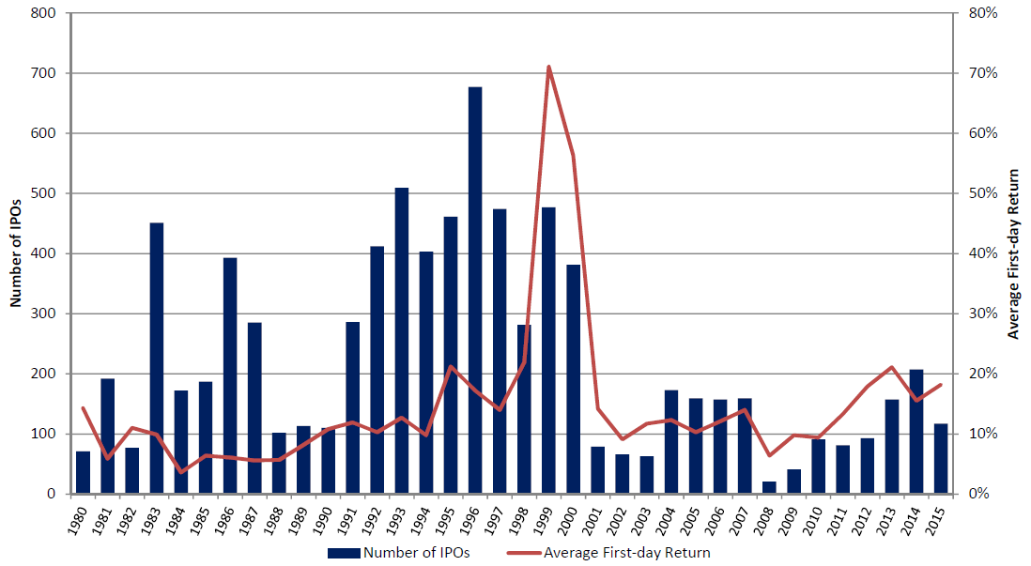
Number of Offerings and Average First-day Return, 1980-2015

